Slide 1
STTP_DevOps ENGINEERING_Day 3
Continuous Testing with Selenium
By – Swarnamber Paul, Oracle

Slide 2
SDLC and Software Testing
The Software Development Life Cycle (SDLC) is a framework that outlines the procedures that must be followed throughout each stage of software development. It includes a thorough outline of the software's development, deployment, and upkeep strategy.
Software testing is the process of assessing and confirming that a software program or product performs as intended. To be precise, it verifies if a software is working as per requirement (SRS).
A test case suite is executed using specialized automated testing software tools as part of the software testing approach known as automation testing. Additionally, the automated testing software may create thorough test reports, compare predicted and actual findings, and insert test data into the System Under Test.

Slide 3
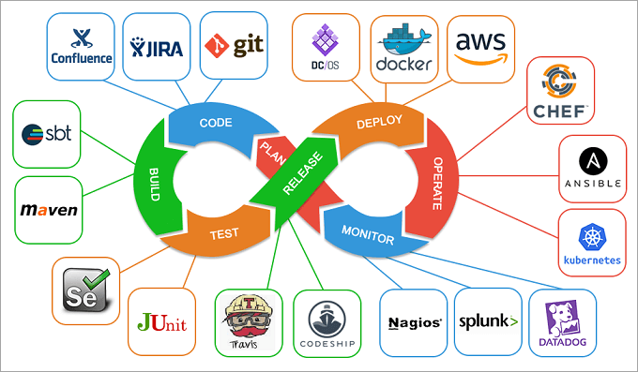

Slide 4
What is SELENIUM
Selenium is a free and opensource web application automation tool. Also we can call it as Functional Testing web application automation tool.
What is Selenium WEBDRIVER
Selenium WebDriver is a web framework that permits you to execute cross-browser tests

Slide 5
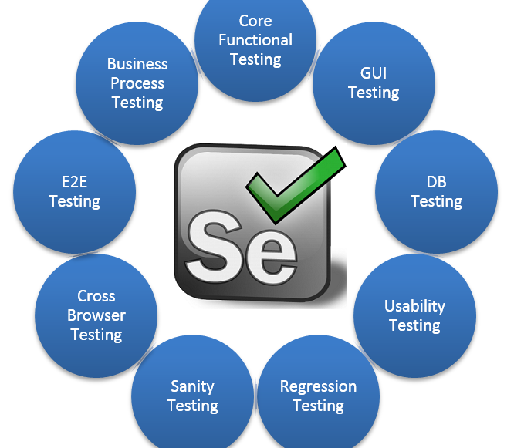
Different aspect of Selenium

Slide 6
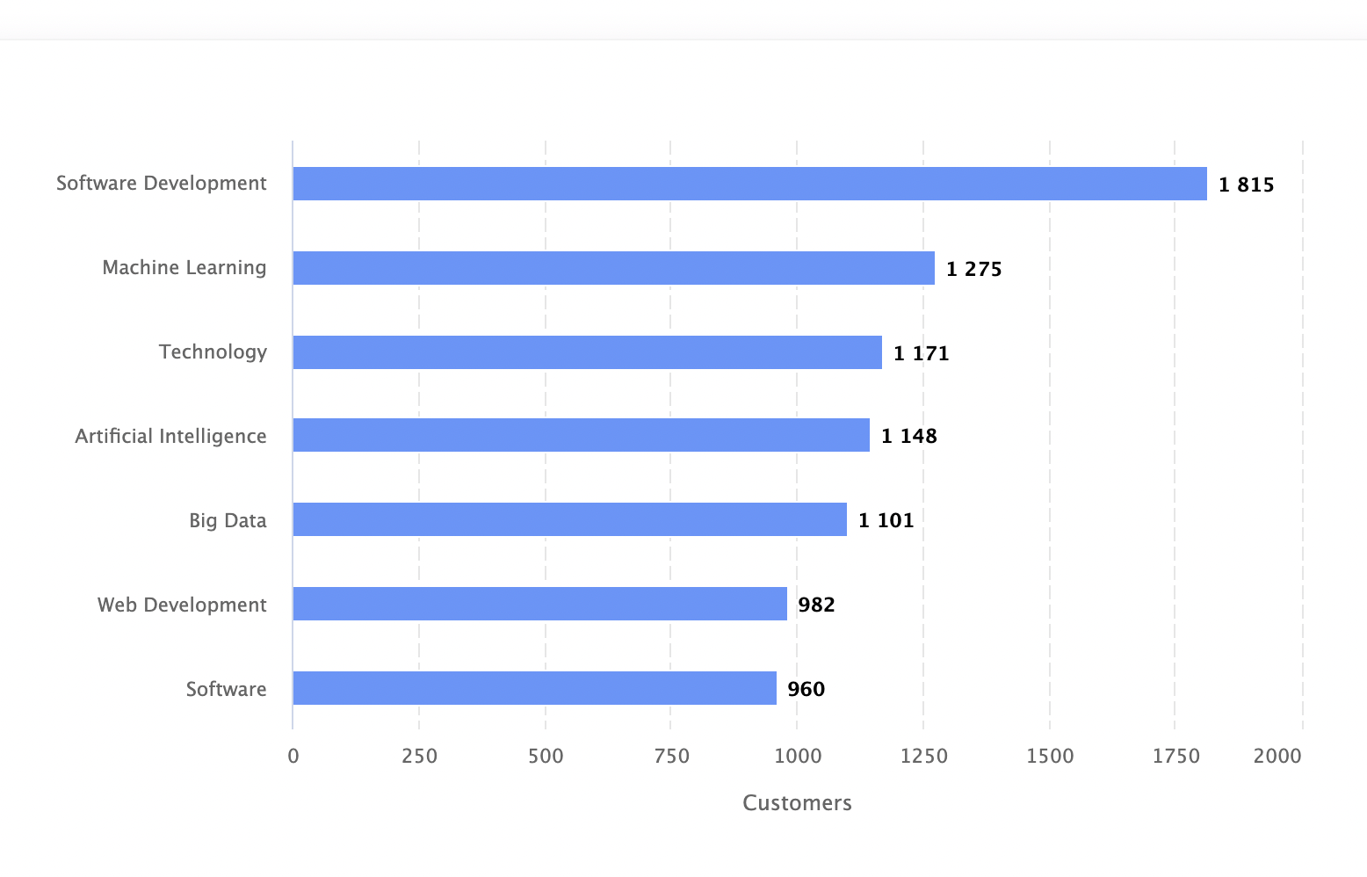
Selenium customers by Industry

Slide 7




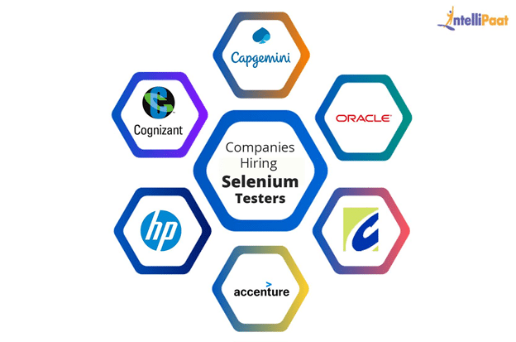









Whats your dream company?
1535 companies reportedly use Selenium in their tech stacks

Slide 8
Flavors of selenium
Selenium RC(Selenium 1) (Deprecated)
Selenium RC was the main Selenium project for a long time, before the WebDriver/Selenium merge brought up Selenium 2, a more powerful tool. It is worth to highlight that Selenium 1 is not supported anymore.
Selenium IDE
An individual who creates test cases for Selenium utilises the Selenium IDE (Integrated Development Environment) primarily as a record/run tool.
Selenium WebDriver (Selenium 2) (Latest V 4.7.2)
Selenium WebDriver is an enhanced version of Selenium RC

Slide 9
How to Download & Install Selenium WebDriver
Selenium installation is a 3 step process:
Install Java JDK ( >=v8)
MAC- https://www.oracle.com/java/technologies/downloads/#jdk19-mac
Windows- https://www.oracle.com/java/technologies/downloads/#jdk19-windows
Install Eclipse IDE
Install Eclipse
https://www.eclipse.org/downloads/download.php?file=/oomph/epp/2022-12/R/eclipse-inst-jre-win64.exe
Install Selenium Webdriver Files from https://www.selenium.dev/downloads/
Install Driver Executables – for browsers (FF -108.0.1, Chrome- 108.0.5359.124 )
Chorme- https://chromedriver.storage.googleapis.com/index.html?path=108.0.5359.71/
Firefox- https://github.com/mozilla/geckodriver/releases
Finally Create a Project in Eclipse

Slide 10
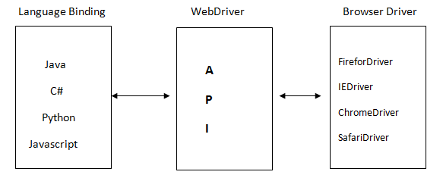
Architecture of selenium webdriver:

Slide 11
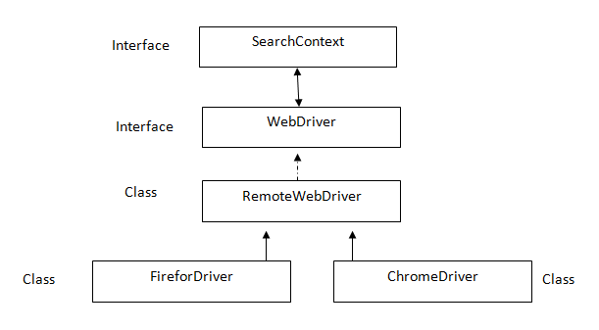
Architecture of webdriver api

Slide 12
What is Locators: locators are used to identify the element.
By.tagName
By.id
By.name
By.className
By.linkText
By.partialLinkText
By.cssSelector
By.xpath
Note – By is a abstract class

Slide 13
Lets get started…
package rait;
import org.openqa.selenium.By;
import org.openqa.selenium.WebDriver;
import org.openqa.selenium.WebElement;
import org.openqa.selenium.firefox.FirefoxDriver;
public class Demo1 {
public static void main(String[] args) {
// WebDriver driver = new FirefoxDriver();
WebDriver driver = new ChromeDriver();
driver.get("https://www.actitime.com/");
By b = By.xpath(“//a[.='Get started']”);
WebElement e = driver.findElement(b);
e.click();
}
}

Slide 14
- using tagName
driver.findElement(By.tagName("a")).click();
Note: In the browser find the element by tag name “a” and click on it.
- using id
driver.findElement(By.id("a1")).click();
- using name
driver.findElement(By.name("n1")).click();
- using className
driver.findElement(By.className("c1")).click();
- using linkText (Google.com)
driver.findElement(By.linkText("actitime")).click();
Note: the locator “linkText” can be used only if the element is a link
(tag of the element should be a).
- using partialLinkText (Google.com)
driver.findElement(By.partialLinkText("acti")).click();
Note: this locator is used to handle dynamic links.
- using cssSelector
<html>
<body>
</body>
UN<input type="text">
PW<input type="password">
</html> Syntax- Tag[AttributeName=“AttributeValue”]
Ex: input[type=“password”]

Slide 15
Many types of xpath – we use based on scenario
Absolute xpath
Relative xpath
xpath by Attribute
xpath by text() function
xpath by contains() function
Traversing in xpath
Independent-Dependent
xpath by group index

Slide 16
Xpath Axis
<Html>
<body>
<select id=”mtr” multiple>
< option value=”a”> Idly</option>
< option value=”b”> Puliyogare</option>
< option value=”c”> Dosa</option>
< option value=”d”> karabath</option>
< option value=”e”> poori</option>
< option value=”f”> poori</option>
</select>
</body>
Child
Descendent
Parent
Ancestor
Following-sibbling
Preceding-sibbling

Slide 17
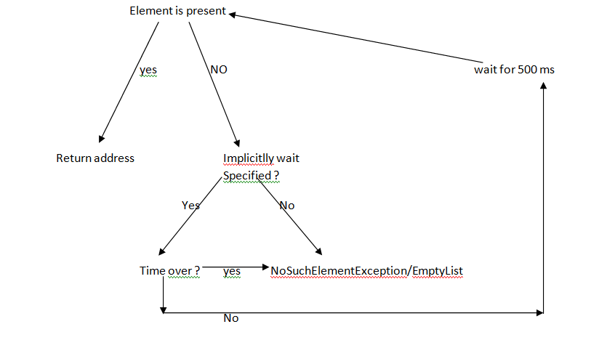
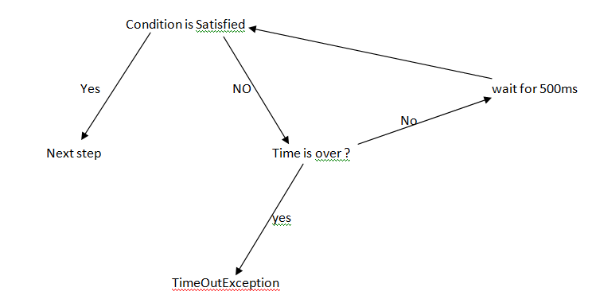
Synchronization in selenium
Process of matching speed of application with selenium is called as synchronization
Implicitlywait
ExplicitWait

Slide 18
Cont..
Example Implicitly Wait
WebDriver driver=new Firefoxdriver(); driver.manage().timeouts().implicitlyWait(10,TimeUnit.DAYS);
driver.manage().timeouts().implicitlyWait(Duration.ofSeconds(10));
TimeUnit can be DAYS, HOURS, MINUTES, SECONDS, MILLISECONDS, MICROSECONDS, NANOSECONDS.
Example ExplicitWait
WebDriverWait wait=new WebDriverWait(driver,10); wait.until(ExpectedConditions.titleContains("Facebook"));
WebDriverWait wait = new WebDriverWait(c, Duration.ofSeconds(10)); wait.until(ExpectedConditions.alertIsPresent());

Slide 19
Runtime polymorphism
We use runtime polymorphism in selenium so that it can execute the script on any browser. In order to do this we use WebDriver.
ChromeDriver driver= new ChromeDriver();
Lets see what is the problem?
Solution?
WebDriver driver= new ChromeDriver();

Slide 20
A script to take screenshot of the application?
package rait;
import java.io.File;
import java.io.IOException;
import org.apache.commons.io.FileUtils;
import org.openqa.selenium.OutputType;
import org.openqa.selenium.WebDriver;
import org.openqa.selenium.firefox.FirefoxDriver;
import org.openqa.selenium.support.events.EventFiringWebDriver;
public class Copyscreenshot {
public static void main(String[] args) throws IOException {
WebDriver driver = new FirefoxDriver();
driver.get("http://localhost/login.do");
TakesScreenshot t= (TakesScreenshot)driver;
File srcfile = t.getScreenshotAs(OutputType.FILE);
File destfile = new File("D:/actitime1.png");
FileUtils.copyFile(srcfile, destfile);
}
}

Slide 21
Handling auto suggestions: We handle auto suggestions using findElements()
Consider a scenario –
1.Open the browser. 2.Enter google.com 3.Type java 4.Get all the autosuggestion 5.print the count. 6.print text of all the autosuggestion. 7.select the last one.
System.setProperty("Webdriver.chrome.driver","D:/chromedriver.exe");
WebDriver driver=new ChromeDriver();
driver.get("https://www.google.co.in");
driver.manage().timeouts().implicitlyWait(10,TimeUnit.DAYS);
driver.findElement(By.id("lst-ib")).sendKeys("java");
String xp="//div[@class='sbqs_c']";
List<WebElement > allast=driver.findElements(By.xpath(xp));
int count=allast.size();
System.out.println(count);
for(int i=0;i<count;i++)
{ WebElement ele =allast.get(i);
String text= ele.getText();
System.out.println(text);
allast.get(2).click();
}
driver.quit();

Slide 22
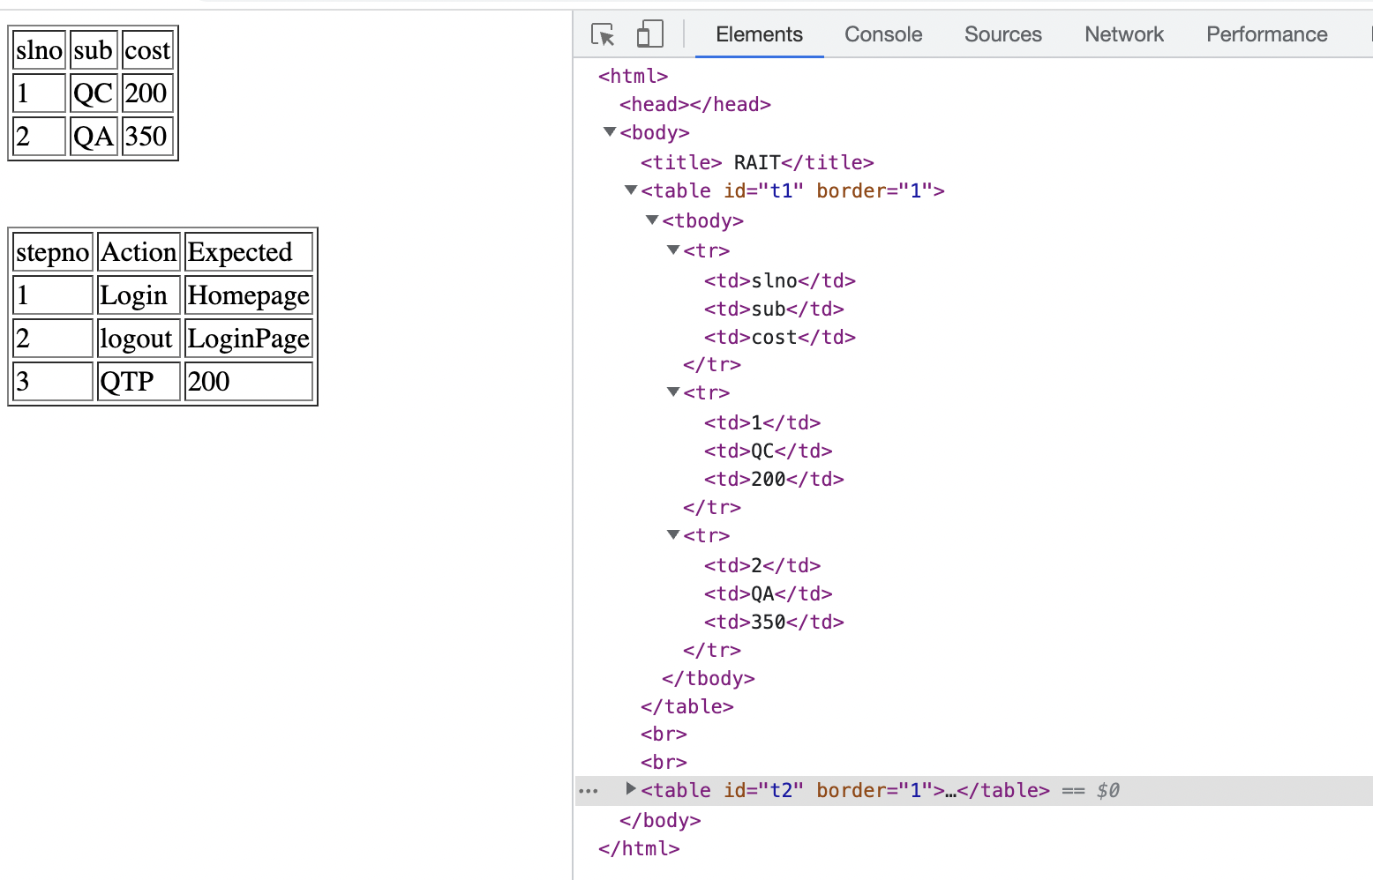
Handling WebTable (html)

Slide 23
Handling WebTable (selenium)
Write a code to print content of the table
System.setProperty("webdriver.chrome.driver","D:/chromedriver.exe");
WebDriver driver=new ChromeDriver();
driver.get("file:///D:/Table.html");
// findElement of WebDriver
WebElement table=driver.findElement(By.id("t1"));
//findelements of WebElement
List<WebElement> allTD = table.findElements(By.tagName("td"));
for(WebElement element:allTD)
{
String text=element.getText();
System.out.println(text);
}
} driver.quit();

Slide 24
Select Class and ListBox Handling
Multi select list box
Single select list box / drop down list
Select class methods -
selectByIndex()
selectByValue()
selecteByVisibleText()
deselectByIndex()
deselectByValue()
deselectByvisibleText()
deselectAll()
isMultiple()
getOptions()
getAllSelectedOptions()
getFirstSelectedOption()
<Html>
<body>
<select id=”mtr” multiple>
< option value=”a”> Idly</option>
< option value=”b”> Puliyogare</option>
< option value=”c”> Dosa</option>
< option value=”d”> karabath</option>
< option value=”e”> poori</option>
< option value=”f”> poori</option>
</select>
</body>

Slide 25
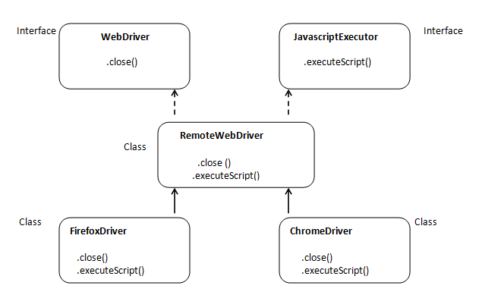
Javascript & Actions in Selenium
Actions actions=new Actions(driver);
actions.contextClick(e).build();
JavascriptExecutor js = (JavascriptExecutor) driver;
js.executeScript("alert('hello world');");

Slide 26
Different Popup handling
Hidden Division Popup (findElement())
File Upload popup (sendKeys())
File Download popup (setPreference() of FirefoxProfile class)
Child browser popup (getWindowHandles() & switchTo())
Alert popups (switchTo())
Frame handling Webpage present inside another webpage is called as embedded webpage.(iframe tag)
Page1.html <iframe name="n1" id="f1" src="page2.html"></iframe> <br> t3:<input type="text" id="t3">
page2.html <title> RAIT</title> usernsame:<input type="text" id="t1" value=”dk@gmail.com"> <br> password:<input type="text" id="t2">

Slide 27
Page object model (POM) & StaleElementReferenceException
POM is one of the Java design pattern.
It is used to develop and test web pages.
in Selenium we use page object model for following reasons:-
To handle stale element reference exception.
To encapsulate the element.
to develop the script in organized way.
In POM class be declared the elements using findby annotation. @findby(locator=“value”) private webElement elementname;
@FindBy(locator=“locator value”) private List<WebElement> elementname;

Slide 28
TestNg (Test Next generation)
Test next generation is a unit testing(WhiteBoxTesting) framework.
It is also used by Selenium automation engineer to run multiple test classes and to generate execution result.
How to install test NG
Open eclipse.
Go to Help -> Eclipse Marketplace...
Do search for TestNG (Type the text TestNG in Find text box > Click Go button)
After searching: Click Install button at TestNG for Eclipse area.
Follow the further instructions by eclipse.
right click on JAVA project
go to build path
click on add libraries click on testNG
click on next
click on finish

Slide 29
- Run multiple test classes - Generate Reports - Rerun only failed classes etc TestNG class is Java class which contains test method. Any method developed using @test annotation is known as test method
package testng;
import org.testng.annotations.Test;
public class DemoA {
@Test
public void testA()
{
System.out.println("TestA");
}
}

Slide 30
Annotation and order of execution
@BeforeSuite
@BeforeTest
@BeforeClass
@BeforeMethod
@Test //here all test method are executed on basis of the criteria(priority…)
@AfterMethod
@AfterClass
@AfterTest
@AfterSuite

Slide 31
Testng.xml
<suite name="Suite">
<test name="Test1">
<classes>
<class name="testng.DemoA"/>
</classes>
</test>
<test name="Test2">
<classes>
<class name="testng.DemoB"/>
</classes>
</test>
</suite>

Slide 32
Assert
To perform comparison or verification we use assert class it should be imported from org.testng.Assert.
Assert class has static method
assertEquals()
assertNotEquals()
assertTrue()
assertFalse()
fail()

Slide 33
Assert
It will not execute remaining statement of current test method if comparison fails.
All methods are static
We don’t have assertAll() method
SoftAssert
It will Execute remaining statement of current test method even if compariosion is fail.
All methods are Non Static
We should call assertAll() method

Slide 34

Contact- +91 7278237683 Mail – spaul9121@gmail.com Feel free to connect @ - https://www.linkedin.com/in/swarnamber/ Resource Link (github) - https://github.com/swarnamber/RAIT/tree/master

Slide 35

Thank You!
Q & A

